Slide 1
JUMP GAME using JAVA
16011086 이한희
15013009 김지은
15010986 신현철
14011104 윤호준

Slide 2
Contents
Topic of Project
Description
1) Change screen
2) Start / Stop / Back Button
3) Jump Thread
4) Collision
3. Demonstration

Slide 3
1. Topic of Project
At first, We decided to make a simple game using java.
So, we make a ‘jumping’ game.
When character jumps successfully, score gets +50 points.
If character crash with obstacle 3 times, game is over &
final score will be appear by using message dialog.

Slide 4

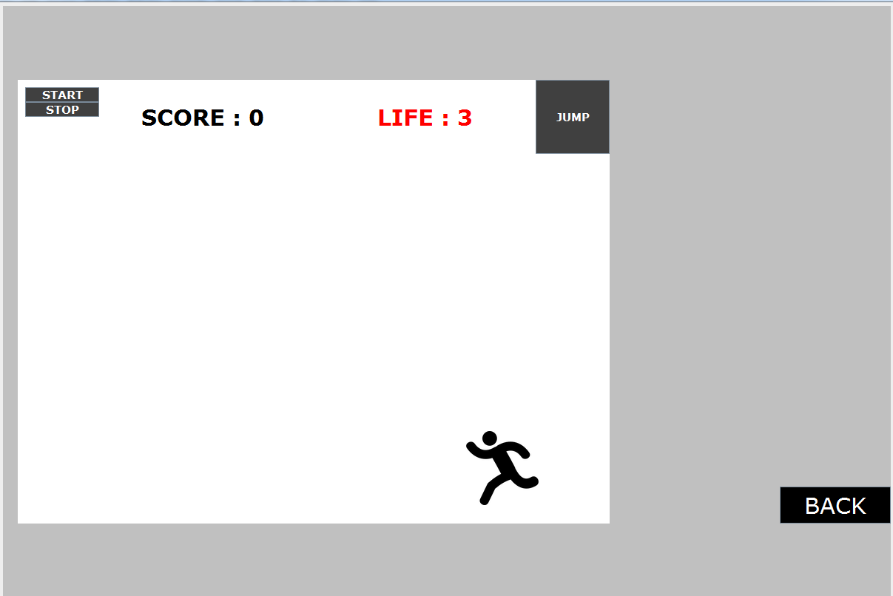
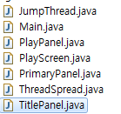
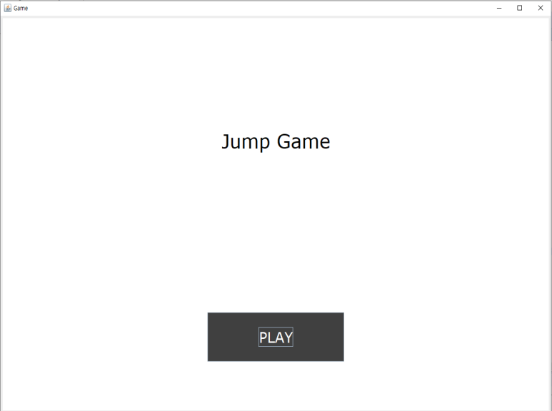

Java files

Slide 5
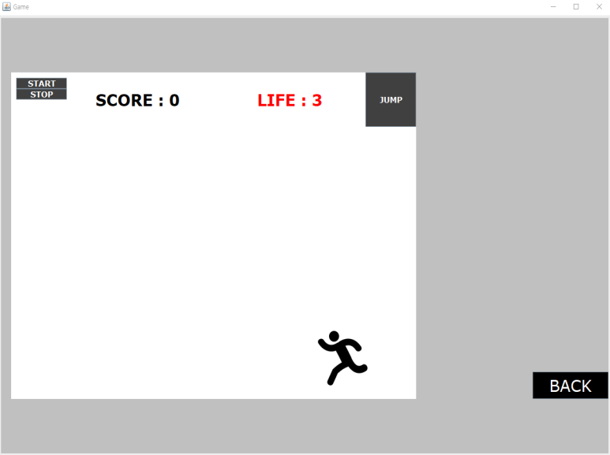
02.
Playing game
Title Panel Play Panel
Play Panel Title Panel

Slide 6
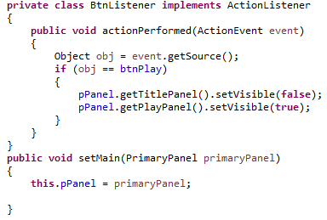


02.
Playing game
Title Panel Play Panel
Title Panel Play Panel
If you click the ‘PLAY’ button, Title panel cannot be visible(setting ‘false’)
And Play panel can be visible(setting ‘true’)
Then, Panel will be changed Title Panel to Play Panel.

Slide 7
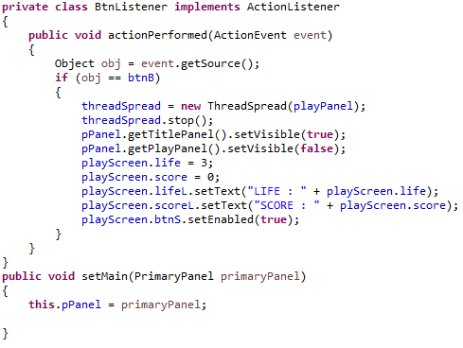

02.
Playing game
Play Panel Title Panel
Play Panel Title Panel
If you click the ‘BACK’ button, Play panel cannot be visible(setting ‘false’)
And Title panel can be visible(setting ‘true’)
Then, Panel will be changed Play Panel to Title Panel.

Slide 8
02.
Playing game
buttons
Start button
Stop button
Back button
Jump button

Slide 9
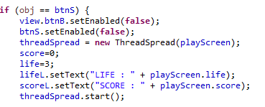
02.
Playing game
Start button
Start button
To play game, click “start” button
It starts with 0 score and 3 lives
When you click start button, “back” button will be disactivated.

Slide 10
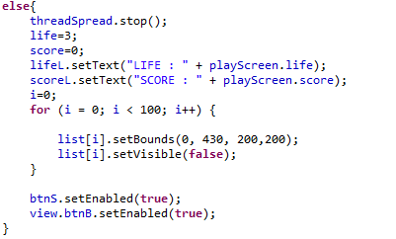
02.
Playing game
Stop button
Stop button
If you want to stop game, click “stop” button
It initialize scores,lives
It makes obstacles invisible
You can go back by clicking “Back” button, or start game using “start” button.

Slide 11
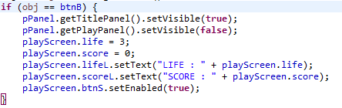
02.
Playing game
back button
Back button
Click the “back” button If you go back to main screen.
Set title panel visible snd play panel invisible
Initialize lives and scores
Set “start” button enabled to make player can play again.

Slide 12

02.
Playing game
Jump button
Jump button
If you can jump, Click the “Jump” button.
The start thread runs.

Slide 13
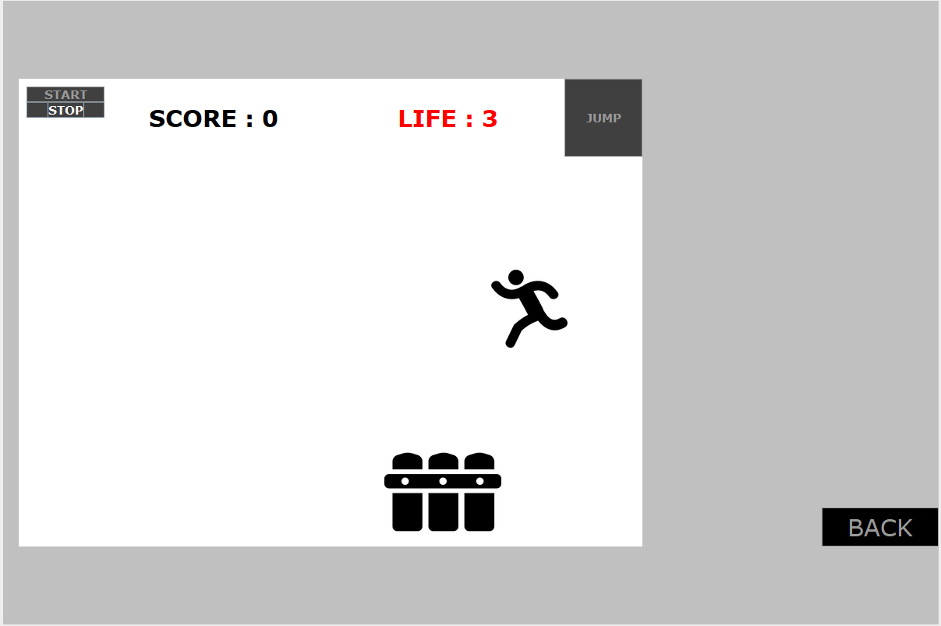
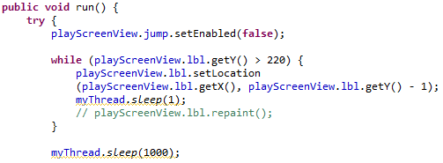
Playing game
02.
Jump button
Jump button
If you click jump button, the button is not visible.
If the icon's y coordinate is greater than 220, It moves by 1 pixel.
The icon goes up to the given value in 0.001 seconds.
The icon waits for 1 second while moving 1 pixel.

Slide 14
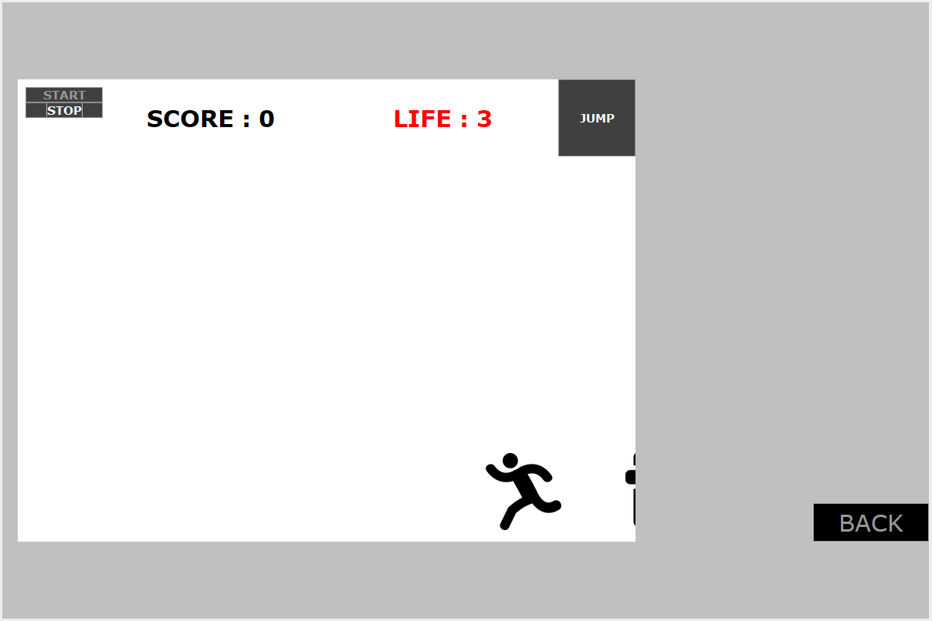
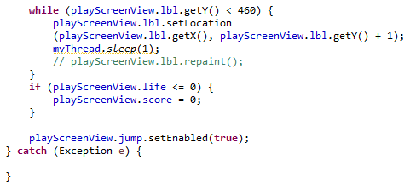
02.
Playing game
Jump button
Jump button
If the icon's y coordinate is less than 460, It moves by 1 pixel.
The icon goes down to the given value in 0.001 seconds. (Initial state)
The jump button will be visible again.

Slide 15
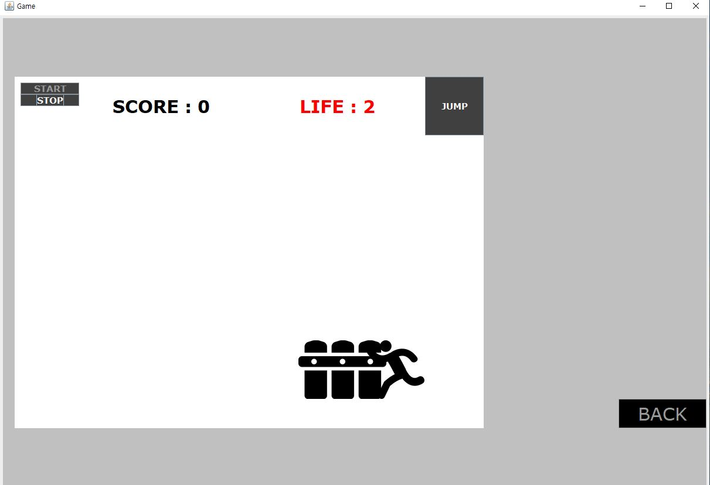
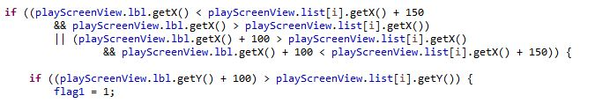
02.
Playing game
Collision
Check the coordinates of the two moving images for collision
When the runner hits a moving hurdle, change the flag to 1.

Slide 16
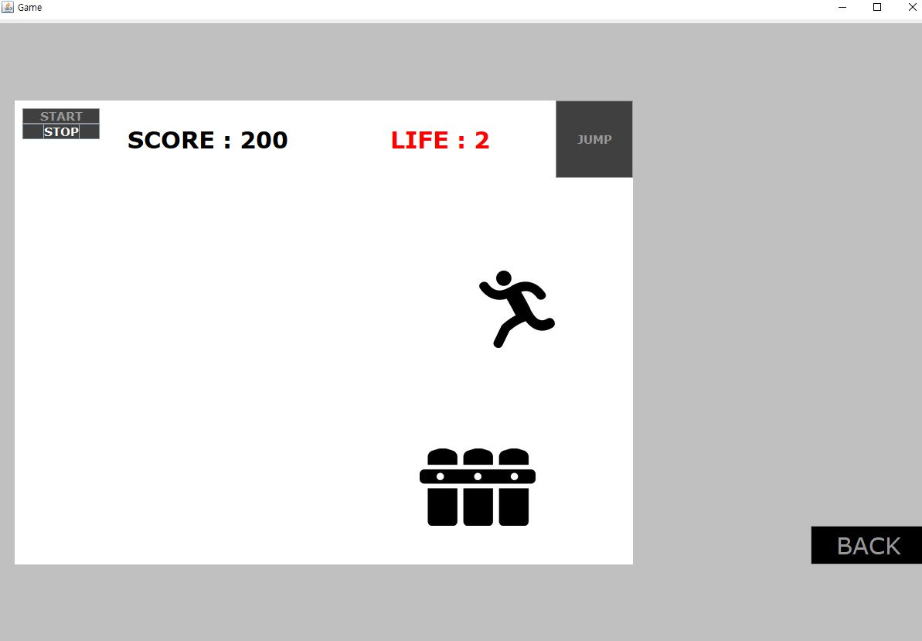
02.
Playing game
Collision
When the hurdle reached the end,
if the runner hits, he will lose his life, or your score will increase by 50 points.

Slide 17
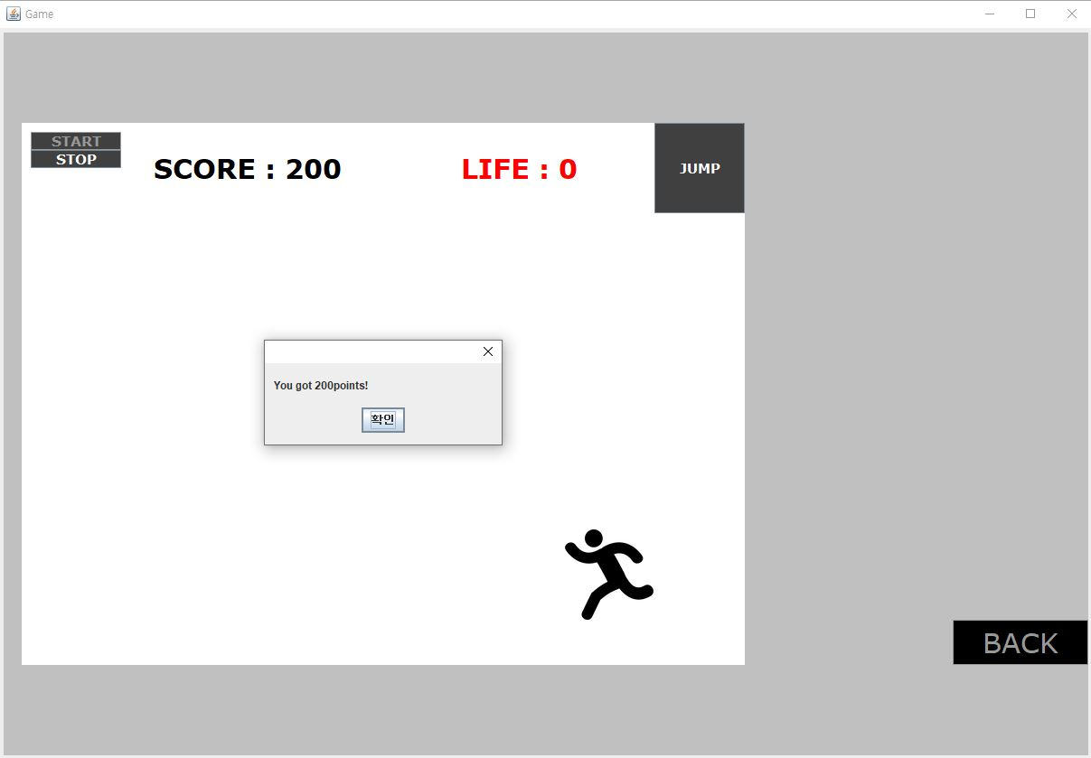
02
Playing game
Collision
Game Over
When life reaches zero, the game ends and the message is displayed.

Slide 18
3.Demonstration

Slide 19
Thanks!

